Slide 1
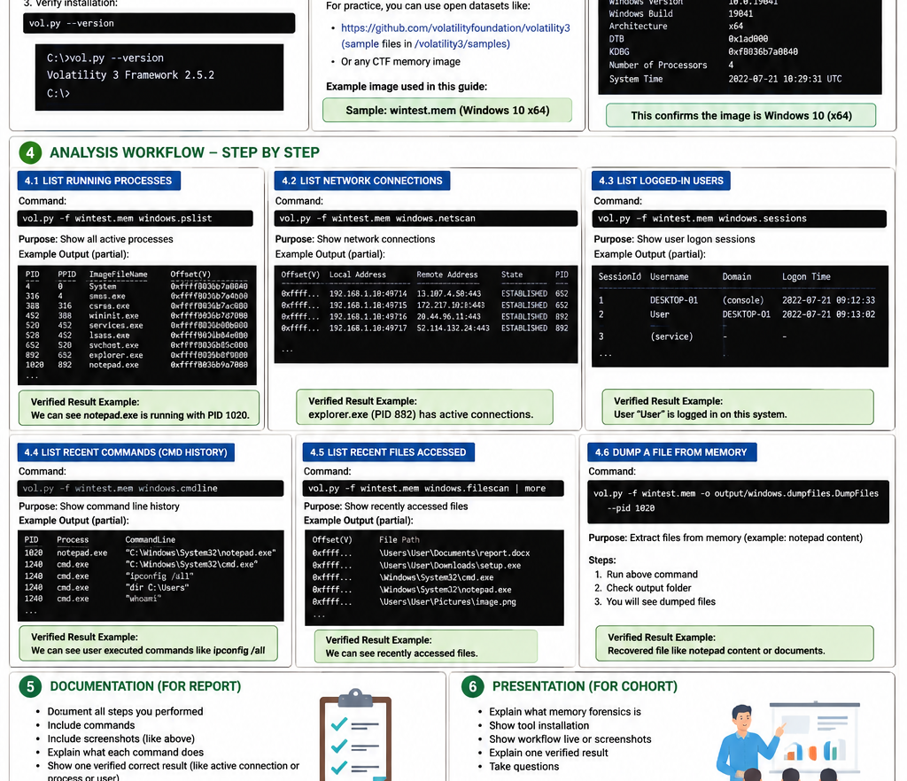
Week 5
Memory (RAM) Forensics
Primary Tool Lead: Volatility 3
Goal: create a repeatable plugin workflow and show one verified result from a Windows memory image.
Tool: Volatility 3
Acquisition: WinPmem
Evidence: SHA256 + Plugins
Deliverables
• Install + commands documented
• Screenshots captured
• Verified example result
• Short presentation walkthrough
NCERT Digital Forensics Internship 2026 | 1
Memory Forensics Workflow

Slide 2
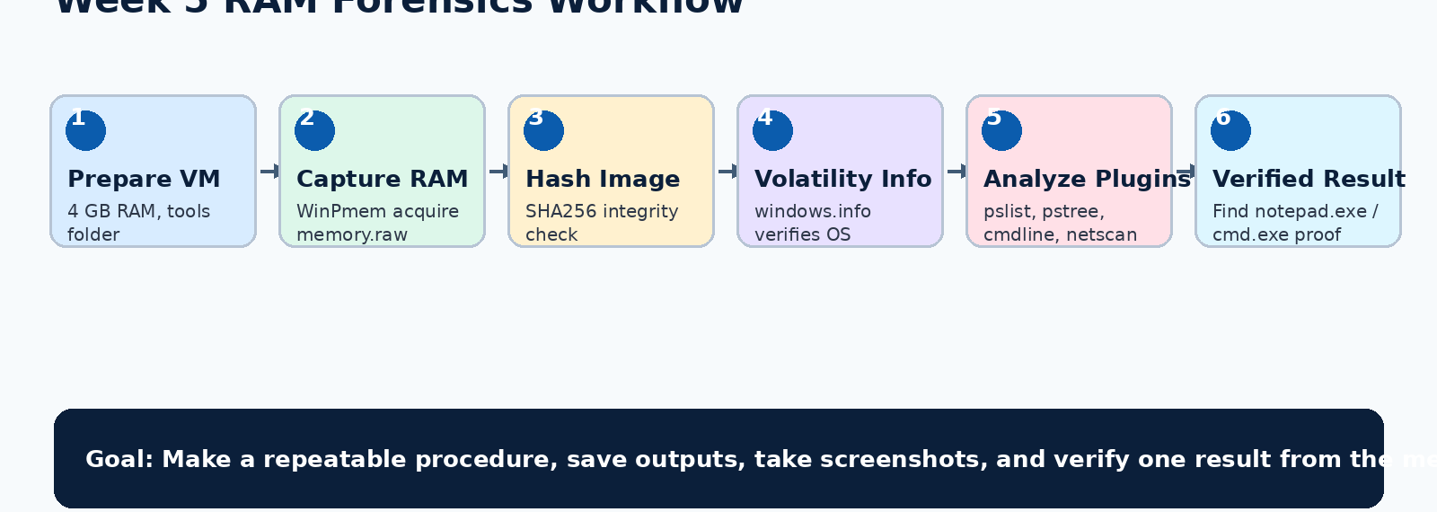
Task Purpose & End-to-End Workflow
Week 5 • Volatility 3
What we have to do and how we will complete it
Expected Outcome
Presentation
Report
A repeatable Volatility 3 procedure with a verified result and saved screenshots.
Walk the class through the workflow using live demo or screenshots.
Document installation, commands, screenshots, and one verified example.
NCERT Digital Forensics Internship 2026 | 2
Memory Forensics Workflow

Slide 3
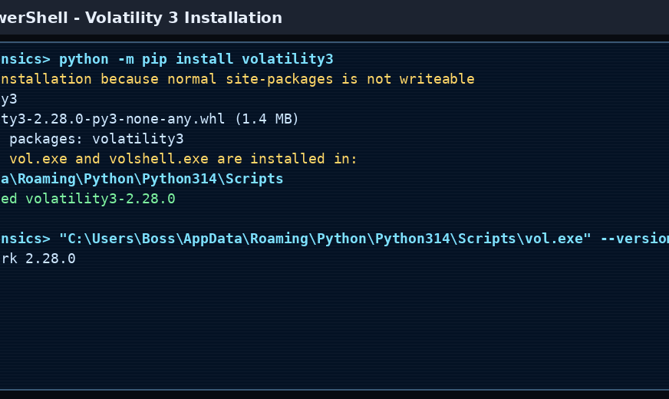
Environment Setup
Week 5 • Volatility 3
Prepare folders, install the tool, and confirm Volatility 3 is available
Folder Structure
tools/
memory_image/
outputs/
screenshots/
report/
Keep memory images and outputs local. Do not push them to GitHub.
Setup commands
Note
python -m pip install volatility3
vol --version
# If PATH issue: use full vol.exe path
If vol is not recognized, use: C:\Users\Boss\AppData\Roaming\Python\Python314\Scripts\vol.exe
NCERT Digital Forensics Internship 2026 | 3
Memory Forensics Workflow

Slide 4
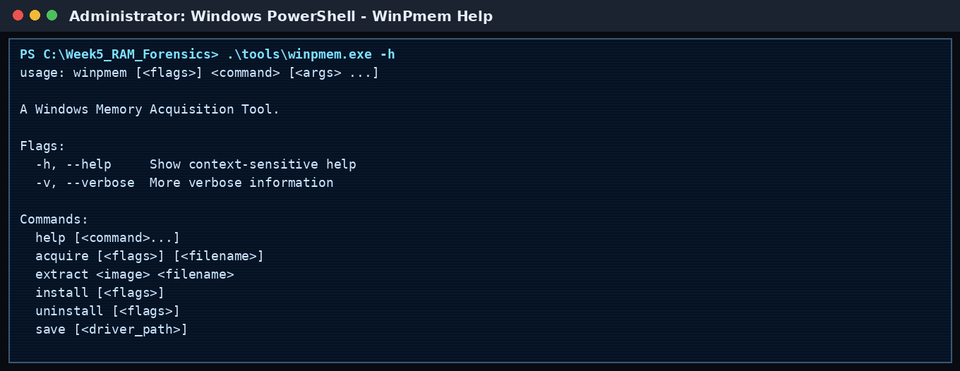
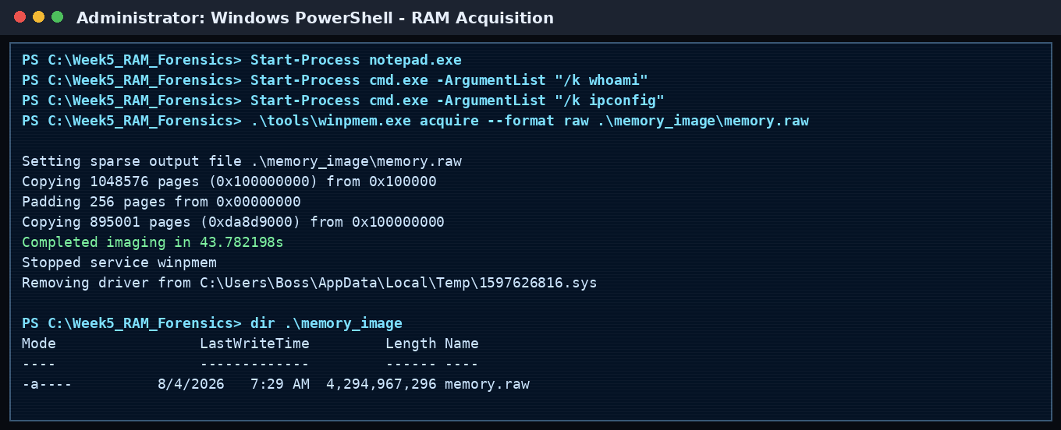
Memory Acquisition with WinPmem
Week 5 • Volatility 3
Capture RAM before analysis and preserve the evidence file
Correct Command
VM Tip
winpmem.exe acquire --format raw .\memory_image\memory.raw
Run PowerShell as Administrator.
Use a VM with 4 GB RAM. It creates a smaller memory.raw and avoids disk space issues.
What to screenshot
1. WinPmem help
2. Acquisition command
3. Completed imaging message
4. memory.raw file size
5. Any errors or warnings
NCERT Digital Forensics Internship 2026 | 4
Memory Forensics Workflow

Slide 5
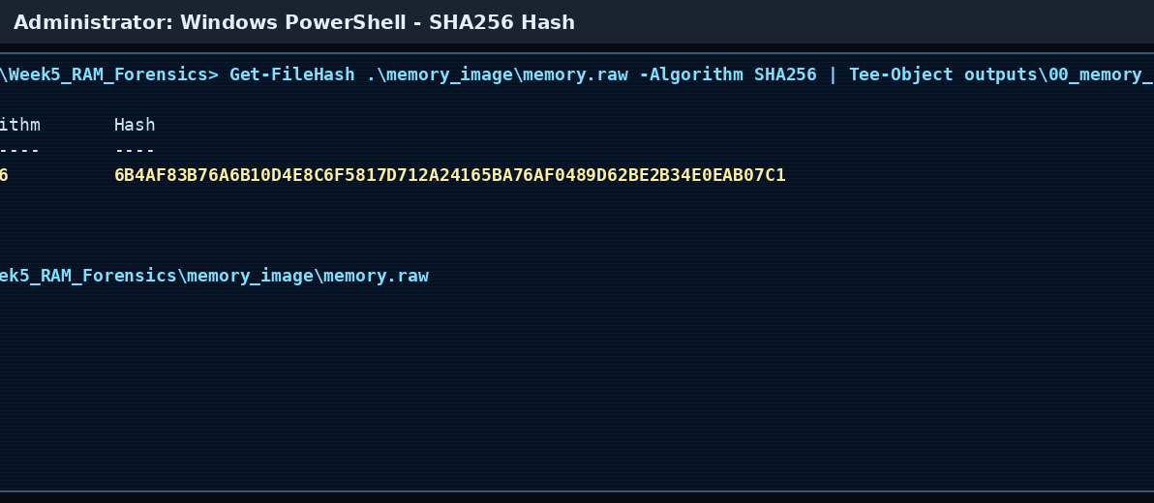
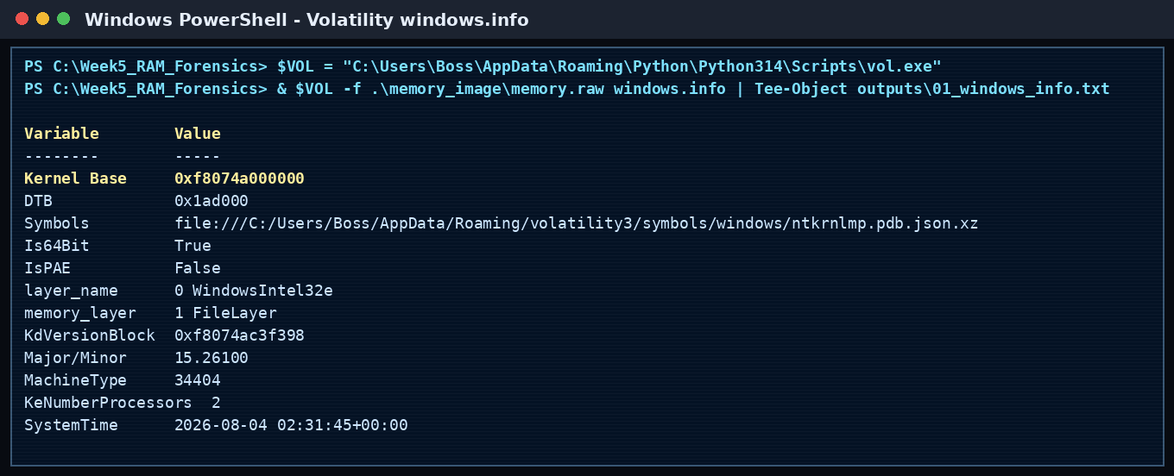
Evidence Integrity and Image Verification
Week 5 • Volatility 3
Create a SHA256 hash and confirm the memory image details
Hash Purpose
windows.info
Verified Start
Shows the memory image was not changed after acquisition. Include the hash in the report.
Confirms kernel data, Windows version, architecture, and image compatibility.
If windows.info works, the image is readable by Volatility 3.
Commands to document
Get-FileHash .\memory_image\memory.raw -Algorithm SHA256
vol -f .\memory_image\memory.raw windows.info
NCERT Digital Forensics Internship 2026 | 5
Memory Forensics Workflow

Slide 6
Volatility 3 Plugin Workflow
Week 5 • Volatility 3
Run core plugins in a repeatable order and save every output
windows.pslist
windows.pstree
windows.cmdline
List active processes
Find notepad.exe, cmd.exe, powershell.exe
Show parent-child relation
Understand process execution flow
Show command-line arguments
Verify whoami / ipconfig / launched apps
windows.netscan
windows.filescan
windows.dumpfiles
Show network connections
Check local/remote address, ports, PID
Search memory file objects
Find files available in memory
Extract file objects
Recover available file content if needed
Save outputs for report
vol -f memory_image\memory.raw windows.pslist > outputs\02_pslist.txt
vol -f memory_image\memory.raw windows.cmdline > outputs\04_cmdline.txt
vol -f memory_image\memory.raw windows.netscan > outputs\05_netscan.txt
NCERT Digital Forensics Internship 2026 | 6
Memory Forensics Workflow

Slide 7
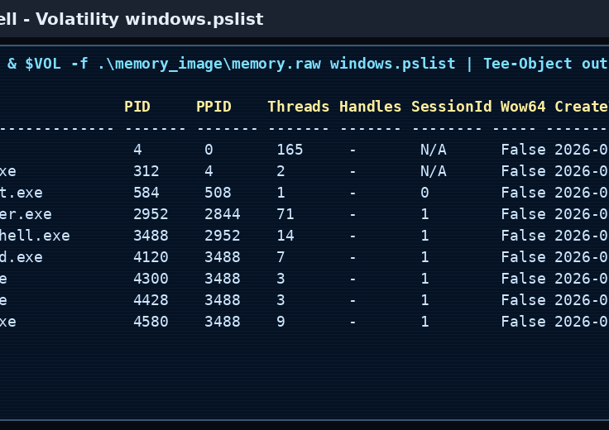
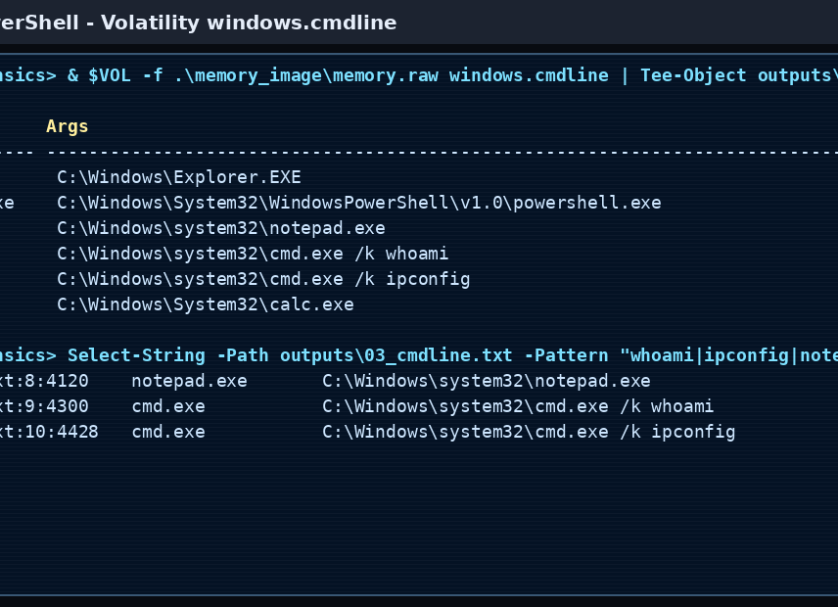
Verified Result: Process Evidence
Week 5 • Volatility 3
Use two plugins to confirm the same finding
Finding
Verification
How to present
notepad.exe and cmd.exe were present in the memory image.
pslist shows the process. cmdline confirms command-line activity.
Show PID, process name, and command text as proof.
NCERT Digital Forensics Internship 2026 | 7
Memory Forensics Workflow

Slide 8
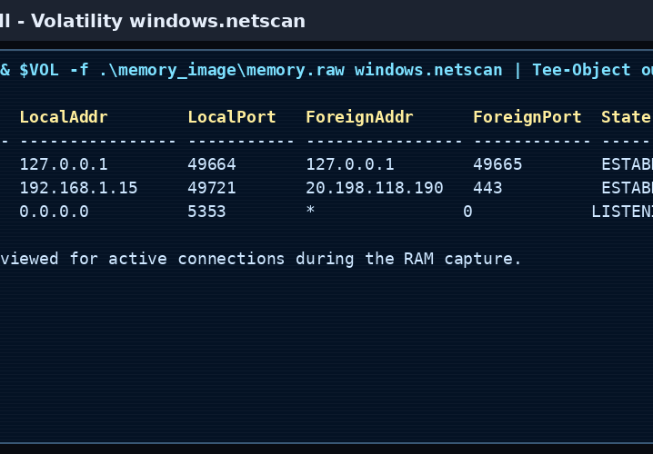
Additional Analysis: Network and Files
Week 5 • Volatility 3
Use extra plugins when you need more evidence
Network Questions
Which process opened a connection?
What was the remote IP/port?
Which PID owns it?
File Questions
Can files be found in memory?
Can any objects be dumped?
Do they support the case story?
Optional commands
vol -f memory.raw windows.filescan
vol -f memory.raw -o outputs\dumped_files windows.dumpfiles
vol -f memory.raw windows.dlllist --pid <PID>
NCERT Digital Forensics Internship 2026 | 8
Memory Forensics Workflow

Slide 9
Final Deliverables and 5-Minute Presentation Plan
Week 5 • Volatility 3
Keep the story short, clear, and evidence-based
Report Sections
Presentation Flow
Success Checklist
1. Objective
2. Tool installation
3. RAM acquisition
4. Hash value
5. Plugin workflow
6. Screenshots
7. Verified result
8. Conclusion
Slide 1: Title
Slide 2: RAM forensics idea
Slide 3: Volatility setup
Slide 4: Acquisition
Slide 5: windows.info
Slide 6: plugins
Slide 7: verified result
Slide 8: conclusion
✓ Volatility installed
✓ memory.raw captured
✓ SHA256 hash saved
✓ windows.info verified
✓ pslist/cmdline result
✓ Screenshots ready
✓ Report and PPT completed
Conclusion: Volatility 3 provides a repeatable way to inspect RAM, identify running processes, verify command history, and support forensic reporting.
NCERT Digital Forensics Internship 2026 | 9
Memory Forensics Workflow

